Slide 1
MODULE CODE: ET 8208
MODULE NAME: DATA STRUCTURE AND ALGORITHMS ANALYSIS
FACILITATOR: BETTY SINGANO

Slide 2
Introduction to Data Structures:
What is data?
Data can be defined as a representation of facts, concepts, or instructions in a formalized manner, which should be suitable for communication, interpretation, or processing by human or electronic machine.
Data can be anything like a number, a name, notes in a musical composition, or the color in a photograph.
Data is represented with the help of characters such as alphabets (A-Z, a-z), digits (0-9) or special characters (+,-,/,*,<,>,= etc.)

Slide 3
Data Types:
Unlike humans, a computer does not know the difference between "1234" and "abcd."
Data types specify the different sizes and values that can be stored in the variable. There are two types of data types:
Primitive data types:
The primitive data types include boolean, char, byte, short, int, long, float and double. Also called built in data types.
Non-primitive data types:
The non-primitive data types include strings, classes, interfaces, and arrays.
Also called user defined data types.

Slide 4
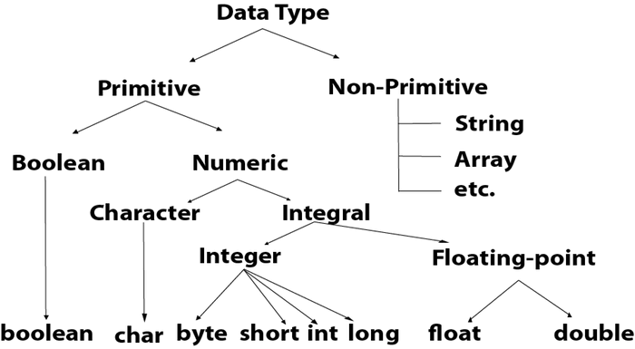

Slide 5
A data type, in programming, is a classification that specifies which type of value a variable has and what type of mathematical, relational or logical operations can be applied to it without causing an error.
It is a classification that dictates what a variable or object can hold in computer programming.
For example a string,, is a data type that is used to classify text and an integer is a data type used to classify whole numbers.
When programmers create computer applications, both desktop and web-based, data types must be referenced and used correctly to ensure the proper result and an error-free program.
Understanding the different data types allows programmers to design computer applications more efficiently and accurately.

Slide 6
The data type defines which operations can safely be performed to create, transform and use the variable in another computation.
When a program language requires a variable to only be used in ways that respect its data type, that language is said to be strongly typed.
This prevents errors, because while it is logical to ask the computer to multiply a float by an integer (1.5 x 5).
It is illogical to ask the computer to multiply a float by a string (1.5 x Alice).
When a programming language allows a variable of one data type to be used as if it were a value of another data type, the language is said to be weakly typed.

Slide 7
Common examples of data types are;
boolean (e.g., true or false)
character (e.g., a)
date (e.g., 03/01/2023)
double (e.g., 1.79769313486232e308)
floating-point number (e.g., 1.234)
integer (e.g., 1234)
long (e.g., 123456789)
short (e.g., 0)
string (e.g., abcd)
void (e.g., no data)

Slide 8
Data Type | Default Value | Default size
boolean | false | 1 bit
char | '\u0000' | 2 byte
byte | 0 | 1 byte
short | 0 | 2 byte
int | 0 | 4 byte
long | 0L | 8 byte
float | 0.0f | 4 byte
double | 0.0d | 8 byte

Slide 9
Abstract data types:
What is abstract data type?
Data types such as int, float, double, long, etc. are considered to be in-built data types and we can perform basic operations with them such as addition, subtraction, division, multiplication, etc.
Now there might be a situation when we need operations for our user-defined data type which have to be defined.
These operations can be defined only as and when we require them. So, in order to simplify the process of solving problems, we can create data structures along with their operations, and such data structures that are not in-built are known as Abstract Data Type (ADT).

Slide 10
An abstract data type is an abstraction of a data structure that provides only the interface to which the data structure must adhere. The interface does not give any specific details about how something should be implemented or in what programming language.
In other words, we can say that abstract data types are the entities that are definitions of data and operations but do not have implementation details.
An Abstract Data Type in data structure is a kind of a data type whose behavior is defined with the help of some attributes and some functions.
Examples of abstract data types in data structure are list, stack, queue etc.

Slide 11
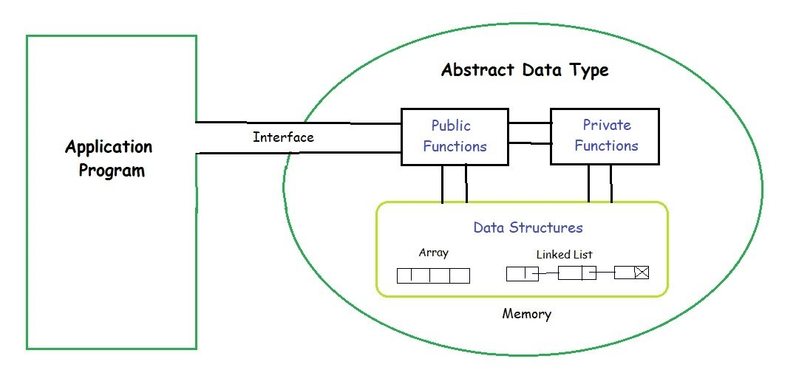
Abstract Data Type Model:

Slide 12
Features of ADT:
Abstract data types (ADTs) are a way of encapsulating data and operations on that data into a single unit.
Some of the key features of ADTs include:
Abstraction: The user does not need to know the implementation of the data structure only essentials are provided.
Better Conceptualization: ADT gives us a better conceptualization of the real world.
Robust: The program is robust and has the ability to catch errors.
Encapsulation: ADTs hide the internal details of the data and provide a public interface for users to interact with the data. This allows for easier maintenance and modification of the data structure.

Slide 13
Data Abstraction: ADTs provide a level of abstraction from the implementation details of the data. Users only need to know the operations that can be performed on the data, not how those operations are implemented.
Data Structure Independence: ADTs can be implemented using different data structures, such as arrays or linked lists, without affecting the functionality of the ADT.
Information Hiding: ADTs can protect the integrity of the data by allowing access only to authorized users and operations. This helps prevent errors and misuse of the data.
Modularity: ADTs can be combined with other ADTs to form larger, more complex data structures. This allows for greater flexibility and modularity in programming.

Slide 14
Advantages:
Encapsulation: ADTs provide a way to encapsulate data and operations into a single unit, making it easier to manage and modify the data structure.
Abstraction: ADTs allow users to work with data structures without having to know the implementation details, which can simplify programming and reduce errors.
Data Structure Independence: ADTs can be implemented using different data structures, which can make it easier to adapt to changing needs and requirements.
Information Hiding: ADTs can protect the integrity of data by controlling access and preventing unauthorized modifications.
Modularity: ADTs can be combined with other ADTs to form more complex data structures, which can increase flexibility and modularity in programming.

Slide 15
Disadvantages:
Overhead: Implementing ADTs can add overhead in terms of memory and processing, which can affect performance.
Complexity: ADTs can be complex to implement, especially for large and complex data structures.
Learning Curve: Using ADTs requires knowledge of their implementation and usage, which can take time and effort to learn.
Limited Flexibility: Some ADTs may be limited in their functionality or may not be suitable for all types of data structures.
Cost: Implementing ADTs may require additional resources and investment, which can increase the cost of development.

Slide 16
Information and its storage representation:
Information is organized or classified data, which has some meaningful values for the receiver.
Information is the processed data on which decisions and actions are based.
Data refers to the symbols that represent people, events, things, and ideas.
Data can be a name, a number, the colors in a photograph, or the notes in a musical composition.
Data Representation refers to the form in which data is stored, processed, and transmitted.

Slide 17
Devices such as smartphones, iPods, and computers store data in digital formats that can be handled by electronic circuitry.
Digitization is the process of converting information, such as text, numbers, photo, or music, into digital data that can be manipulated by electronic devices.
The 0s and 1s used to represent digital data are referred to as binary digits — from this term we get the word bit that stands for binary digit. • A bit is a 0 or 1 used in the digital representation of data. • A digital file, usually referred to simply as a file, is a named collection of data that exists on a storage medium, such as a hard disk, CD, DVD, or flash drive.

Slide 18
Representing Numbers: • Numeric data consists of numbers that can be used in arithmetic operations.
• Digital devices represent numeric data using the binary number system, also called base 2.
• The binary number system has two digits only : 0 and 1. • No numeral like 2 exists in the system, so the number “two” is represented in binary as 10 (pronounced “one zero”).

Slide 19
Representing Numbers;
DECIMAL (BASE 10) | BINARY(BASE 2)
0 | 0
1 | 1
2 | 10
3 | 11
4 | 100
5 | 101
6 | 110
7 | 111
8 | 1000
9 | 1001
10 | 1010
11 | 1011
1000 | 1111101000

Slide 20
Representing Text: • Character data is composed of letters, symbols, and numerals that are not used in calculations. • Examples of character data include your name, address, and hair color. • Character data is commonly referred to as “text.”
Digital devices employ several types of codes to represent character data, including ASCII, Unicode, and their variants. • ASCII (American Standard Code for Information Interchange, pronounced “ASK ee”) requires seven bits for each character. • The ASCII code for an uppercase A is 1000001.
Extended ASCII is a superset of ASCII that uses eight bits for each character. • For example, Extended ASCII represents the uppercase letter A as 01000001. • Using eight bits instead of seven bits allows Extended ASCII to provide codes for 256 characters.

Slide 21
Unicode (pronounced “YOU ni code”) uses sixteen bits and provides codes or 65,000 characters. • This is a bonus for representing the alphabets of multiple languages. • UTF-8 is a variable-length coding scheme that uses seven bits for common ASCII characters but uses sixteen-bit Unicode as necessary.
ASCII codes are used for numerals, such as Social Security numbers and phone numbers. • Plain, unformatted text is sometimes called ASCII text and is stored in a so-called text file with a name ending in .txt. • On Apple devices these files are labeled “Plain Text.”
In Windows, these files are labeled “Text Document”.

Slide 22
ASCII text files contain no formatting.
To create documents with styles and formats, formatting codes have to be embedded in the text.
Microsoft Word produces formatted text and creates documents in DOCX format.
Apple Pages produces documents in PAGES format.
Adobe Acrobat produces documents in PDF format.
HTML markup language used for Web pages produces documents in HTML format.

Slide 23
Bits and Bytes: • All of the data stored and transmitted by digital devices is encoded as bits. • Terminology related to bits and bytes is extensively used to describe storage capacity and network access speed. • The word bit, an abbreviation for binary digit, can be further abbreviated as a lowercase b. • A group of eight bits is called a byte and is usually abbreviated as an uppercase B.
When reading about digital devices, you’ll frequently encounter references such as 90 kilobits per second, 1.44 megabytes, 2.8 gigahertz, and 2 terabytes. • Kilo, mega, giga, tera, and similar terms are used to quantify digital data.

Slide 24
Use bits for data rates, such as Internet connection speeds, and movie download speeds.
Use bytes for file sizes and storage capacities.
104 KB: Kilobyte (KB or Kbyte) is often used when referring to the size of small computer files.
56 Kbps: Kilobit (Kb or Kbit) can be used for slow data rates, such as a 56 Kbps (kilobits per second) dial-up connection.
50 Mbps: Megabit (Mb or Mbit) is used for faster data rates, such as a 50 Mbps (megabits per second) Internet connection.
3.2 MB: Megabyte (MB or MByte) is typically used when referring to the size of files containing photos and videos.
100 Gbit: Gigabit (Gb or Gbit) is used for really fast network speeds.
16 GB: Gigabyte (GB or GByte) is commonly used to refer to storage capacity.

Slide 25
Data Compression: • To reduce file size and transmission times, digital data can be compressed. • Data compression refers to any technique that recodes the data in a file so that it contains fewer bits. • Compression is commonly referred to as “zipping.”
Compression techniques divided into two categories: lossless and lossy • Lossless compression provides a way to compress data and reconstitute it into its original state; uncompressed data stays exactly the same as the original data • Lossy compression throws away some of the original data during the compression process; uncompressed data is not exactly the same as the original.

Slide 26
Software for compressing data is sometimes referred to as a compression utility or a zip tool.
On laptops and desktop computers, the compression utility is accessed from the same screen used to manage files.
The process of reconstituting files is called extracting or unzipping.
Compressed files may end with a .zip, .gz, .pkg, or .tar

Slide 27
Definition of Data Structure:
What is data structure?
A data structure is a way of organizing and storing data in a computer memory/program so that it can be accessed and used efficiently.
Data structures provide a means of:
managing large amounts of data,
enabling efficient searching,
sorting,
insertion, and
deletion of data.

Slide 28
Categories of data structures:
Data structures can be categorized into two types:
Primitive data structures
Non-primitive data structures.
Primitive data structures are the most basic data structures available in a programming language, such as integers, floating-point numbers, characters, and booleans.
Non-primitive data structures are complex data structures that are built using primitive data types, such as arrays, linked lists, stacks, queues, trees, graphs, and hash tables.

Slide 29
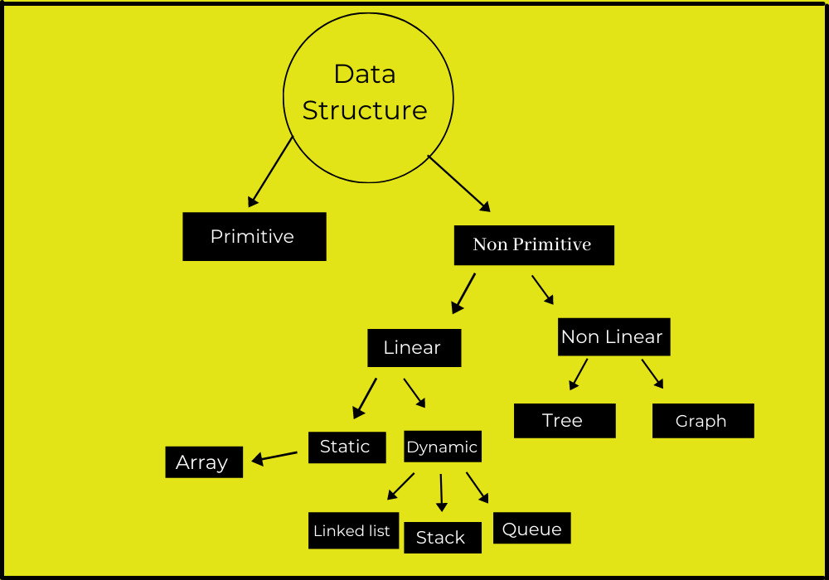

Slide 30
Classification of Data Structure:
Linear data structure:
Data structure in which data elements are arranged sequentially or linearly, where each element is attached to its previous and next adjacent elements, is called a linear data structure. Examples of linear data structures are array, stack, queue, linked list, etc.
Static data structure:
Static Data Structures are data structures where the size is allocated at the compile time. Hence, the maximum memory size is fixed and cannot be changed. It is easier to access the elements in a static data structure. An example of this data structure is an array.
Dynamic data structure:
Dynamic Data Structures are data structures where the size is allocated at the run time. Hence, the maximum size is flexible and can be changed as per requirements.
Examples of this data structure are queue, stack, etc.

Slide 31
Non-linear data structure:
Data structures where data elements are not placed sequentially or linearly are called non-linear data structures.
In a non-linear data structure, we can’t traverse all the elements in a single run only. Examples of non-linear data structures are trees and graphs.

Slide 32
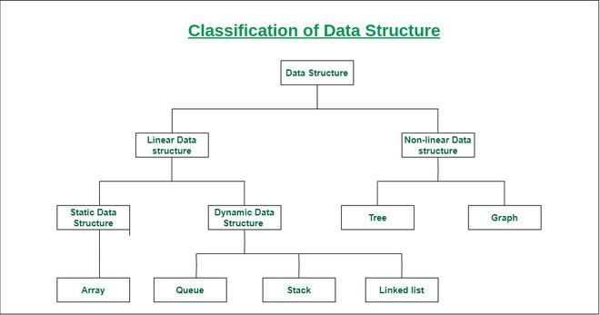

Slide 33
Need of Data Structure:
Applications are becoming more complex and the amount of data is increasing day by day, which may cause problems with processing speed, searching data, handling multiple requests etc.
Data structure provides a way of organizing, managing, and storing data efficiently.
With the help of data structure, the data items can be traversed easily.
Data structure provides efficiency, reusability and abstraction.
It plays an important role in enhancing the performance of a program because the main function of the program is to store and retrieve the user’s data as fast as possible.

Slide 34
Characteristics of Data Structures:
Correctness:
Data structure implementation should implement its interface correctly.
Time complexity:
Running time or the execution time of operations of data structure must be as small as possible.
Space complexity:
Memory usage of a data structure operation should be as little as possible.
Execution time cases:
There are 3 cases which are usually used to compare various data structures execution time in a relative manner.
Worst case: data structure operation takes maximum time it can take.
Average case: depicts the average of execution time of an operation of a data structure.
Best case: depicts the least possible execution time of an operation of a data structure.

Slide 35
Thank you.

